Slide 1

Weekly Report
DAW Project

Slide 2
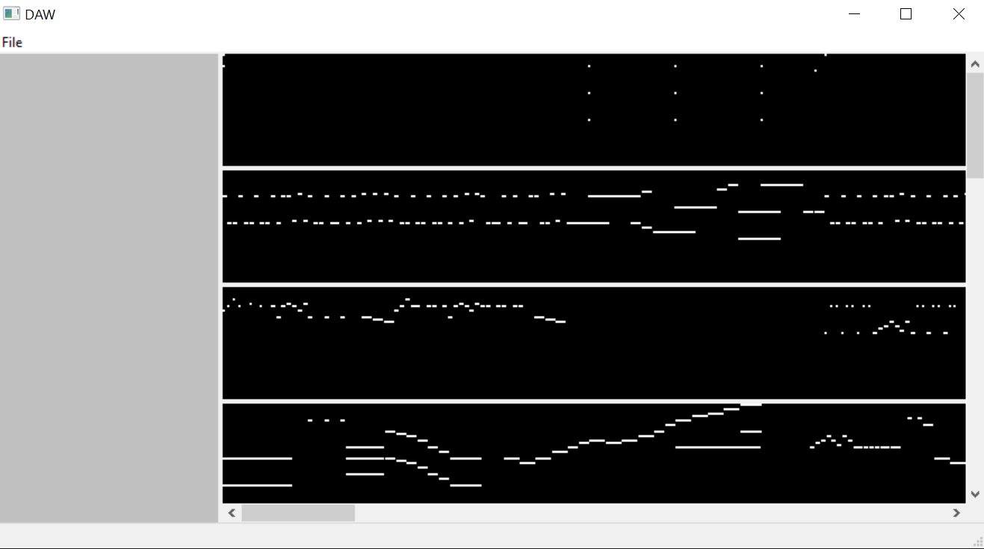

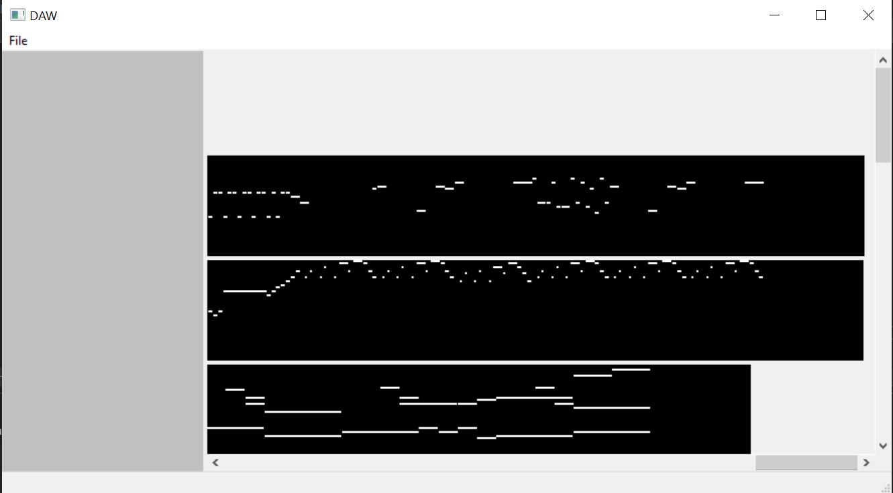
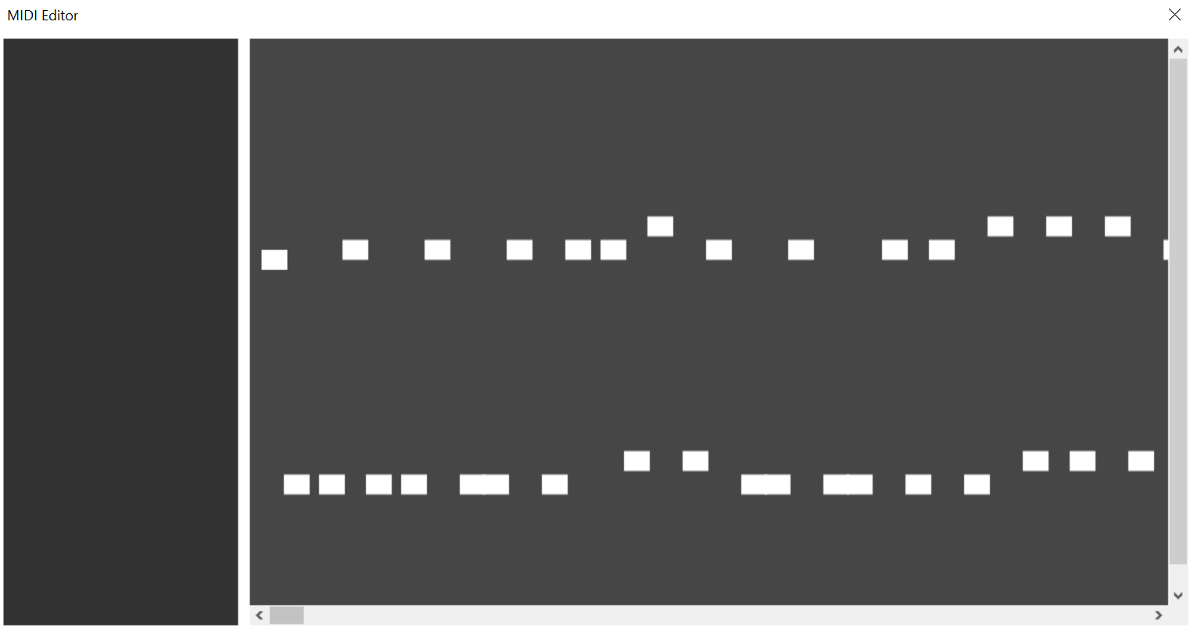
Scrolling
DAW Project Report
Scrolling issue was fixed and added to the editor window, though it is not yet implemented into the main program.

Slide 3
Note Stretching Rework
Note stretching was reworked, now works in a more intuitive way

Slide 4
Saving Editor Changes
Changes in the editor are now saved, including moved notes, added notes, stretched notes, and removed notes.
Changes also appear on the main window as well.

Slide 5
Struggles this week
DAW project
Major issues with custom events
Laptop breaking

